Slide 1
Linear and Planar Density
Dr. Ranjit Kumar
Department of Chemical Engineering
Email: ranjit.kumar@snu.edu.in

Slide 2
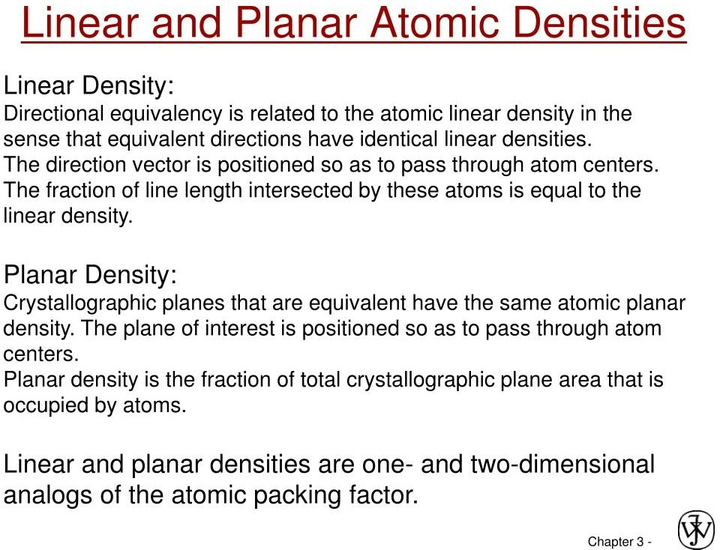

Slide 3
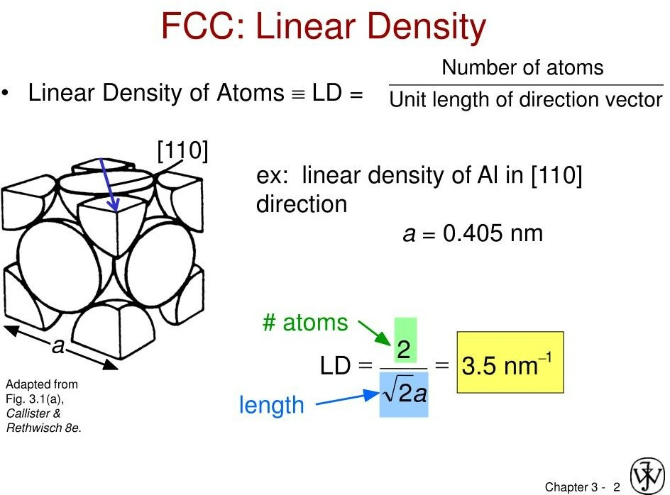

Slide 4
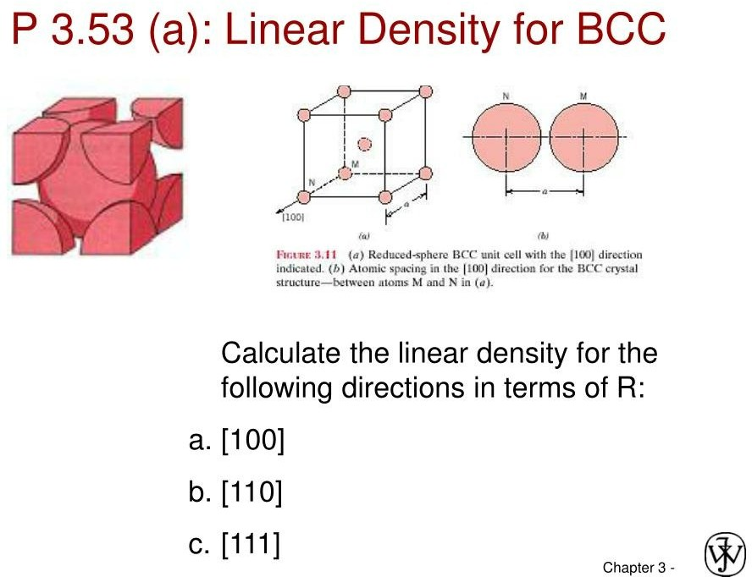

Slide 5
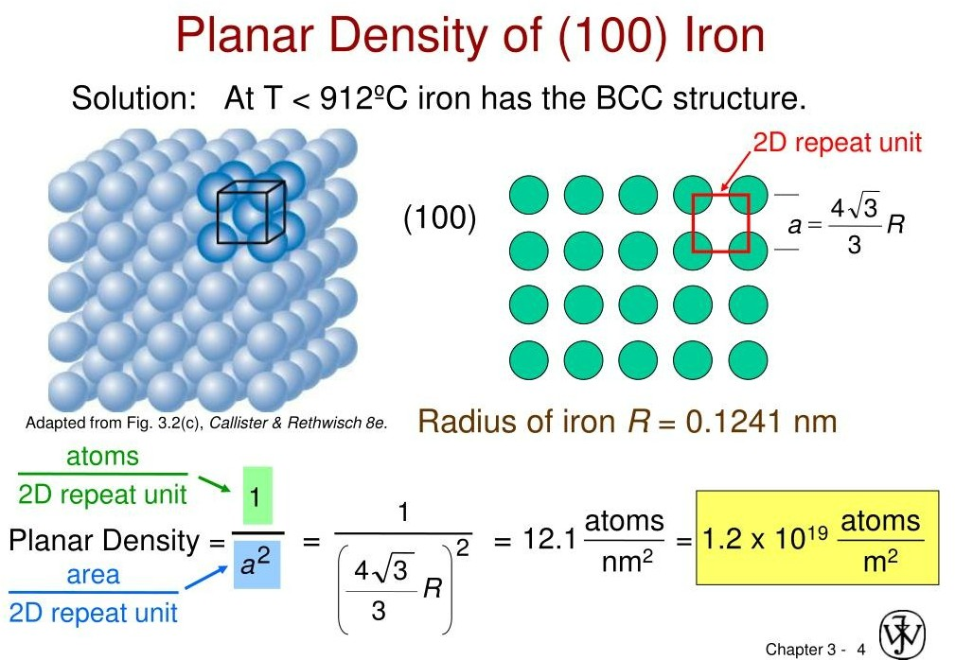

Slide 6
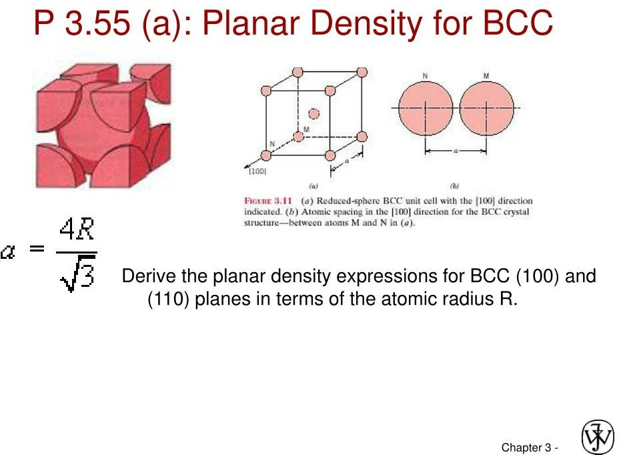

Slide 7
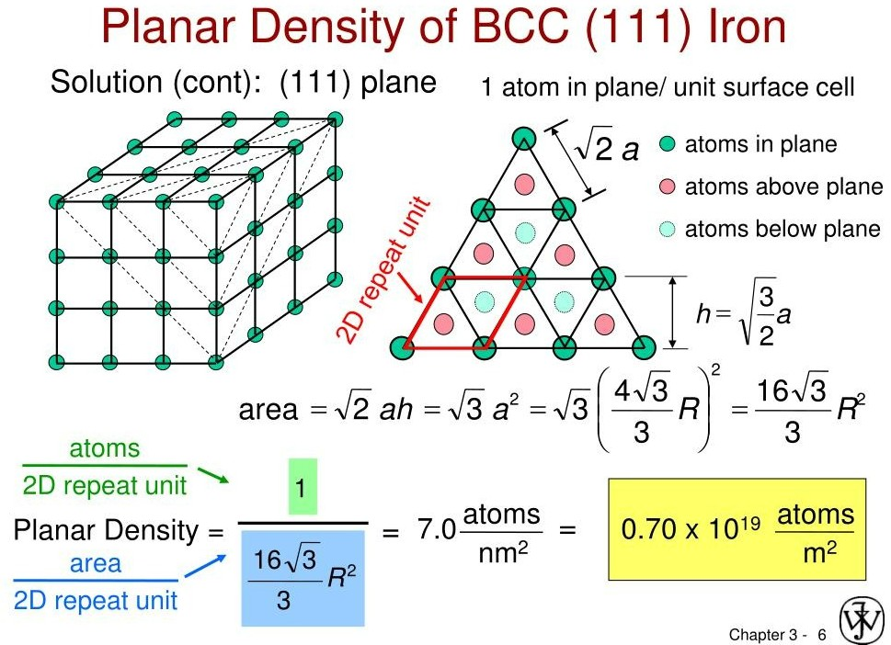

Slide 8
